Slide 1
Book Club Application
CSSE 357 Engineering Full-Stack Applications
Fall 2024
Final Project
Jennifer Greene
S1381886@monmouth.edu

Slide 2
Project Description
Book Club Application
Full-stack web application for a book club
Tracks books borrowed and returned that were added by members

Slide 3
Book Club Model Objects
Members – member data
Books – book data and cover
Borrows – borrow and return information with timestamps
Credentials – login information

Slide 4
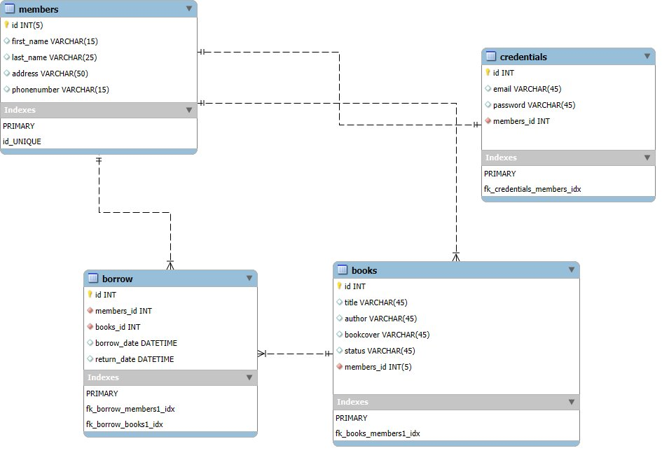
Book Club ER Diagram

Slide 5
Book Club Database
4 Tables
Primary and foreign key constraints
Models for all database interaction
MySQL workbench used for DB design
phpMyAdmin for hosting database

Slide 6
Implementation for Database
Models for each table in database
4 models, 23 DB queries, encryption on sensitive information

Slide 7
Portal Design
1 Login page to the application
HTML design – CSS in Login and Library
9 views – Login, signup, library, new book, borrow book, return book, update status, book log, and member's books

Slide 8
Portal Implementation
MVC methodology – HTML/ view page, controller,, and model files using PHP
Use of PDO in Models
Use of php variable $_SESSION for user data between controllers
Use of JavaScript to validate forms

Slide 9
Demo
Code snippets
Controllers and models communication
Model to database interaction through PDO
Navigating the Book Club Application

